Slide 1
Project Ideas
For Project Sapana

Slide 2
Project Ideas for Project Sapana
Nepali / English typing website
JS Game
Speech to Text or vice versa using python
Letter identification project using python
Blogging Website

Slide 3
1. Nepali / English typing website
A typing website inspired from monkeytype.com, keybr.com with support for English, Nepali typing tests, tests analytics, different font styles, graphs, maps representing user’s typing data analytics.

Slide 4
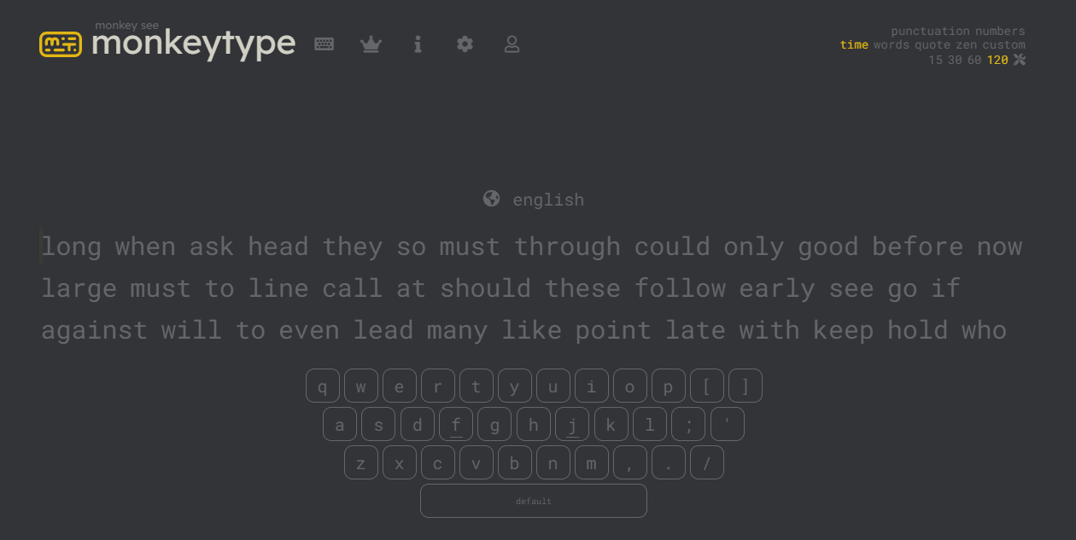

Slide 5
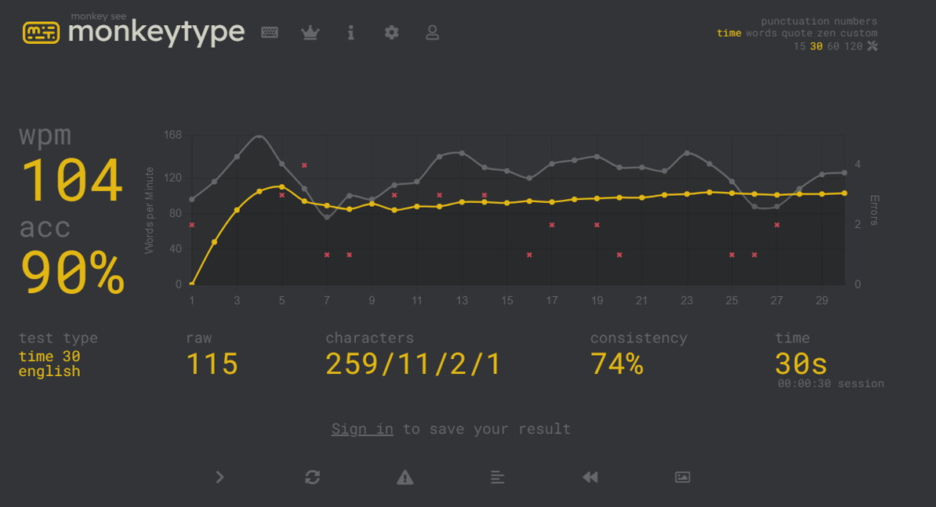

Slide 6
2. JS Game
JavaScript is very popular scripting language and it is broadly used for game development as well.
Games ideas may be (Tic Tac Toe, Hangman, Snake Game, Chrome Dinosaur, Quiz Game)

Slide 7
3. Speech to Text or vice versa
It is a python project idea where python speech recognition packages will be used to recognize speech and converted into text.
Speech recognition packages like wit, apiai, google-cloud-speech packages.
Text to speech packages gTTS (Google Text-to-Speech)

Slide 8
4. Letter Identification
It is a python project that helps to identify the letters from an image and videos

Slide 9
5. Blogging Website
Blogging is very common website idea but our website project ideas includes these points that makes it unique.
Features:
News related to (Education, Business, Health, Technology, Politics)
Personal blogging account for blogs upload & journal writing.
Roadmaps for various fields related to technology
A simple JS Game
Books related to various subjects and interests.
Chatbot

Slide 10
Purpose of blogging website
News: Updates user with day to day activities in different sector worldwide.
Personal blogging provides a platform where user’s posts not only provides the useful information but also learning opportunities for others as well.
Journaling is one of the proven medicine for mental growth.
Roadmaps provides users with a proper guided learning paths for future technological career.
Books are one of the best ways to learn so this website helps to create a platform to provide books that provide knowledge out of classroom.

Slide 11
Features of blogging website

Slide 12
THANK YOU

